Slide 1
Checklist based testing
Muhammad Umer Farooque (02-131192-059)
Sumayya Khalid (02-131192-057)

Slide 2
What Is Checklist-Based Testing?
Checklist-based testing is a type of software testing based on the pre-planned “to-do” list of tasks called a checklist.
Checklists provide a shorthand way of writing the functionality, putting the core action at the top. It’s thus much more easy to write a checklist item than a test case.
It includes a number of tests that help to determine whether the product is ready for deployment. And if not, it helps to find out which components must be reworked.

Slide 3
Where & Why checklist based testing
Checklist-based testing is widely used by QA experts advocating for its convenience and productivity. Main reasons to use this type of tests are:
Creating test cases is extremely time-consuming. Much like code, its requirements can change with every sprint, rendering your test cases obsolete, and warranting an update. All of this takes more time than testers usually have in development structures.
Easy to create/use/maintain
Analyzing results (task progress/completion status) is super easy
Very flexible – you can add or remove items as needed

Slide 4
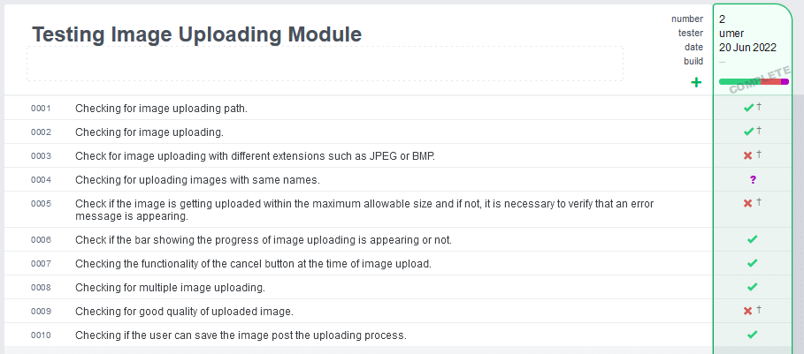
Example #1
My Test Report

Slide 5
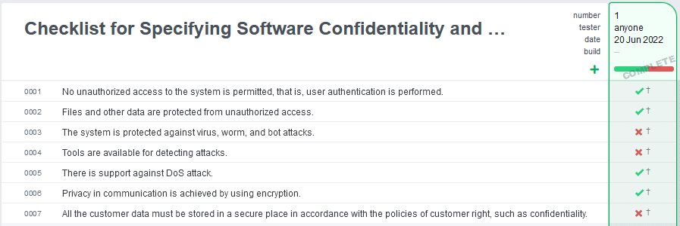
Example #2
My Test Report

Slide 6
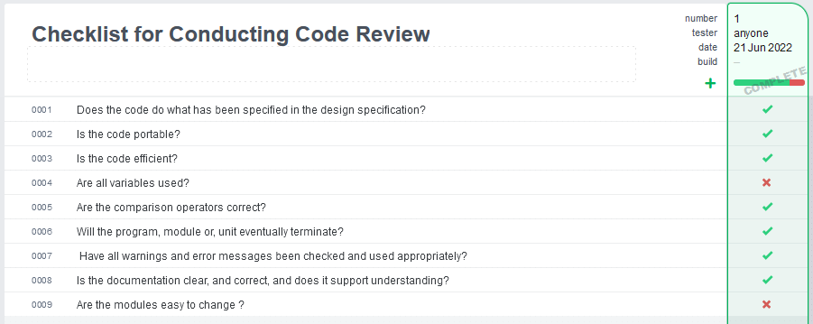
Example #3
My Test Report

Slide 7
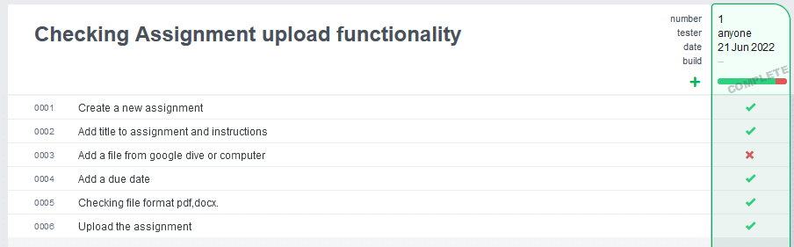
Example #4
My Test Report

